Slide 1
Tracking Anime
eProject Sem02_T3.2307.E1_TrackingAnime_Group05

Slide 2

Hello! We are group 05
Our Members: 1. Lê Vinh Chí (Leader)
2. Phạm Hoàng Minh Quân
3. Thân Thế Lộc

Slide 3
Table of contents.
01
Introduction
We will talk about our outline.
02
Tasks
We will talk about tasks of each member.
03
Application Functions
Then, we will talk about application functions.
04
Technology
We talk about technologies and frameworks used.
05
Limitations and difficulties Side
We will also talk about this.
06
Q&A
And we will talk about this last.

Slide 4
Introduction
We will talk about this first.
01
We are talking about how to tracking your anime and why our app can be useful for you.

Slide 5
Problem?
You need to record a large amount of anime to track. Have you finished watching it, when is it airing and where is it airing?
You can write it down on paper to remember, but it will make you feel tired and exhausted if the number becomes too large.
Of course, you can use a third-party software like AnimeList for example. But it's too much detail makes you difficult to approach.

Slide 6
Solution?
That's why we created Tracking Anime. It’s a smart, simple, and beautiful application designed to effortlessly manage your entire anime world, so you can get back to what matters: the anime itself."

Slide 7
Tasks
We will talk about tasks of each member.
02

Slide 8



This is our team.
Vinh Chí
Minh Quân
Thế Lộc
- Search anime with Jikan API, show Anime - Add anime to tracking
- View, filter and setting tracking Anime
Add and Manage Anime, season and studio from local
- Analysis Tracking data
- Show notification when time coming

Slide 9
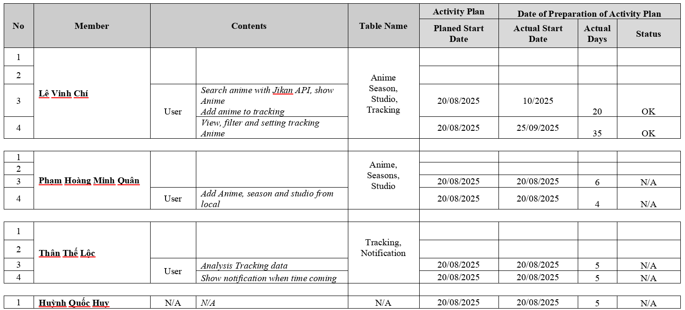
Tasksheet

Slide 10
Application Functions
03
Add anime tracking from JikanAPI
You can add anime from local if you can find it.
Change status of tracking list (watching, plan to watch, on hold,...)

Slide 11
More
You can set your time and day on week.
Our application can show weekly schedule of currently watched anime.
Statistical analysis of number of tracked anime.
Send notification when your tracking was set.

Slide 12
Technology
04
We used the technologies below to build the app.
JavaFX
Maven
JPA with hibernate + Lombok
GSON Library to work with API

Slide 13
Limitations and difficulties Side
05
01
Completeness
02
UI/UX
Notification feature is not complete.
Interface is not eye-catching
03
Team work
04
Extensibility
Members lack initiative in work
May be in future, our app can be integrated AI.

Slide 14
Thank you!
Do you have any questions?

